Slide 1
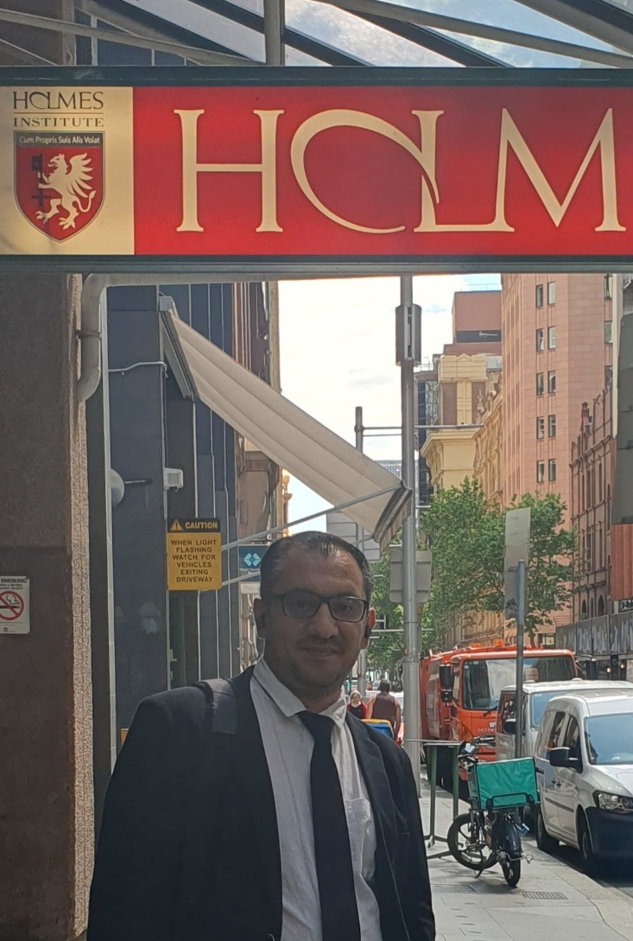

HI6034: Enterprise Information Systems Preparation for Online Test 3 (Week 4 and 5)

Slide 2
Question 1
Question 1
Where are vendors mainly used?
Sales
Finance (FI)
Both Finance and Purchasing
Explanation: Vendors are used when buying goods (purchasing) and when making payments (finance).

Slide 3
Question 2
Which step belongs to the Finance (FI) part in purchasing?
Create Purchase Order
Record Vendor Payment
Request Quotation
Explanation: FI handles money, so paying vendors is part of it.

Slide 4
Question 3
Which statement is correct?
Supplier owns goods until paid fully
Customer owns goods immediately after delivery
None are correct
Explanation: Ownership often stays with supplier until full payment.

Slide 5
Question 4
What is the first step in a purchasing process?
Create Purchase Order
Check Stock List
Send Invoice
Explanation: You first check if you need materials.

Slide 6
Question 5
All materials in stock are free to use.
True
False
Explanation: Some stock may be restricted or reserved.

Slide 7
Question 6
Customer master data only stores basic information.
True
False
Explanation: It stores many details like address, payment, and orders.

Slide 8
Question 7
A quotation request forces a supplier to sell.
True
False
Explanation: It is just asking for prices, not a legal agreement.

Slide 9
Question 8
Which statement is correct?
Goods always belong to customer after delivery
Supplier may still own goods until payment
Both are correct
Explanation: Payment completion matters for ownership.

Slide 10
Question 9
Which process happens in sales distribution?
Create Sales Order
Pay Vendor
Create Purchase Order
Explanation: Sales deals with selling to customers.

Slide 11
Question 10
Which is NOT part of a sales document?
Header
Items
Payment system
Explanation: Sales documents have header and items, not payment systems.

Slide 12
Question 11
What does a Purchase Order do?
Requests goods
Confirms buying goods
Pays supplier
Explanation: It is an official order to a supplier.

Slide 13
Question 12
Who creates an invoice?
Customer
Vendor
Warehouse
Explanation: Vendors send invoices to request payment.

Slide 14
Question 13
What happens after goods are delivered?
Payment is made
Goods are received
Order is created
Explanation: Delivery comes before payment.

Slide 15
Question 14
Which module handles customer orders?
FI
Sales and Distribution (SD)
HR
Explanation: SD manages selling processes.

Slide 16
Question 15
What is a vendor?
A buyer
A supplier
A customer
Explanation: Vendors provide goods or services.

Slide 17
Question 16
Which step comes after quotation?
Purchase Order
Payment
Delivery
Explanation: After comparing quotes, you place an order.

Slide 18
Question 17
Goods Issue means:
Receiving goods
Sending goods out
Paying for goods
Explanation: Goods leave the company.

Slide 19
Question 18
What is master data?
Temporary data
Stored important data
Deleted data
Explanation: It contains long-term information like customers/vendors.

Slide 20
Question 19
Which is part of purchasing?
Invoice receipt
Hiring staff
Marketing
Explanation: Purchasing includes receiving and paying invoices.

Slide 21
Question 20
What is a quotation?
A payment
A price offer
A delivery note
Explanation: Vendors give quotations to show prices.

